Slide 1

PREDICTION OF POST SURGERY LIFE EXPECTANCY IN LUNG CANCER PATIENTS
DATA 245- Final Project Review
GROUP 2
SAMIKSHA PANDEY
HIMABINDU NAYANI
VARUNIKA RAJA
VENKATA SAI KUSUMA SINDHOORA VANKAYALA SIVA

Slide 2
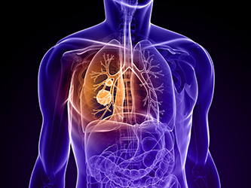
Motivation
Thoracic Cancer is a type of lung cancer
Only 56% cases detected in early stages are survived
Thoracic Cancer Surgery increases the life expectancy
Post surgery deaths are high
Early Detection increases survival rate
Manifestation of Thoracic Cancer in Affected Patients

Slide 3
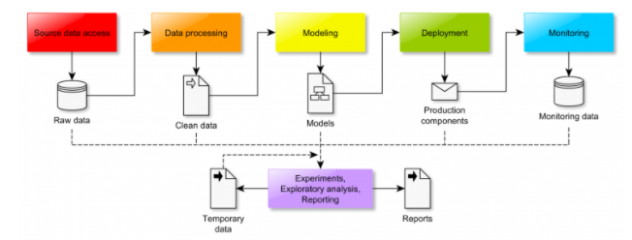
Problem Understanding
Post Thoracic Surgery Survival Prediction
Utilize Patient’s attributes and existing medical conditions
Supervised Learning
Binary Classification problem
Class labels: death/survival in one year post-op
Classification Workflow

Slide 4
Data Understanding
Domain Research and understanding
Dataset
Data Exploration
Feature Distribution

Slide 5
Dataset
The dataset is taken from the UCI Machine Learning repository.
The data is taken from patients who underwent major lung surgeries for primary lung cancer in the years 2007-2011
retrospectively collected at the Wroclaw Thoracic Surgery Centre
It consists of 470 instances and 18 attributes

Slide 6
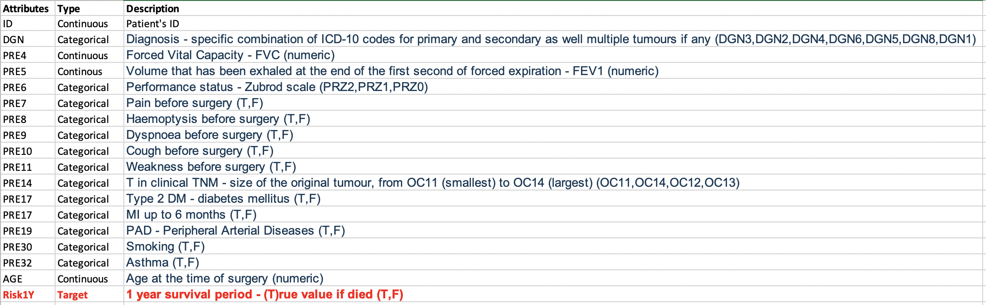
Attribute Information

Slide 7
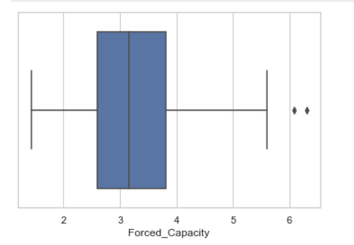
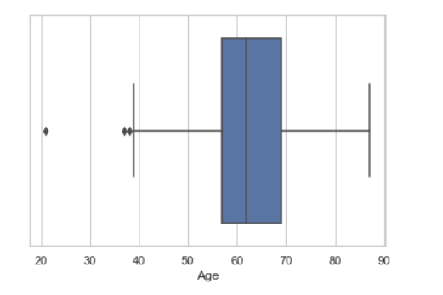
Exploratory Data Analysis
No Missing Values.
No duplicates found in data.
Outliers are observed in Forced Expiration and Forced Capacity.
Age has few outliers at the lower end.

Slide 8
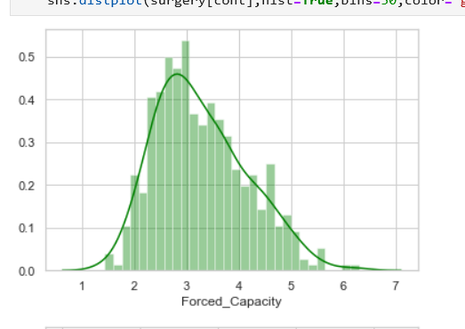
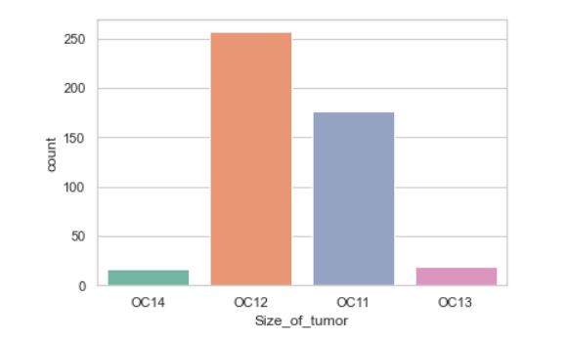
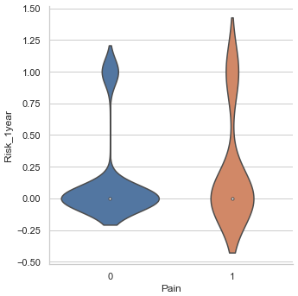
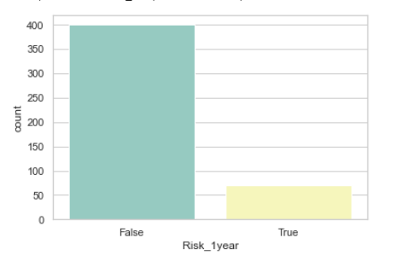
Feature Distributions
Descriptive Features
The Distributions of the Descriptive Features (above) and the Target features (right) of the dataset. Fields analyzed during EDA.
Target Features

Slide 9
Modeling
Random Forest
K-Nearest Neighbors
Naive Bayes
Decision Tree
Logistic Regression
Support Vector Machines

Slide 10
Evaluation
Stratified K Fold Cross Validation
Model is trained using (k-1) folds training data and remaining one fold as test data
Used GridSearchCV for tuning the parameters
Metrics used are classification accuracy, confusion matrix, F1 score and AUC score

Slide 11
Results on Imbalanced data
 | Accuracy | Mean cross validation score | Mean precision score | Mean Recall score | Mean F1 score
KNN | 0.85 | 0.84 | 0 | 0 | 0
SVC | 0.85 | 0.84 | 0 | 0 | 0
Decision Tree | 0.79 | 0.84 | 0.02 | 0.014 | 0.019
Naive Bayes | 0.22 | 0.25 | 0.16 | 0.98 | 0.28
Random Forest | 0.85 | 0.85 | 0 | 0 | 0
Logistic Regression | 0.85 | 0.85 | 0 | 0 | 0

Slide 12
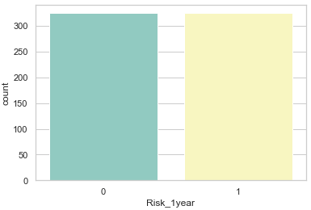
Sampling Techniques
SMOTE
Adaptive Synthetic Sampling
Borderline-SMOTE SVM
Borderline-SMOTE
K-means SMOTE
Random OverSampling
Near Miss - Undersampling Technique
Visualization of target feature after over sampling of training dataset

Slide 13
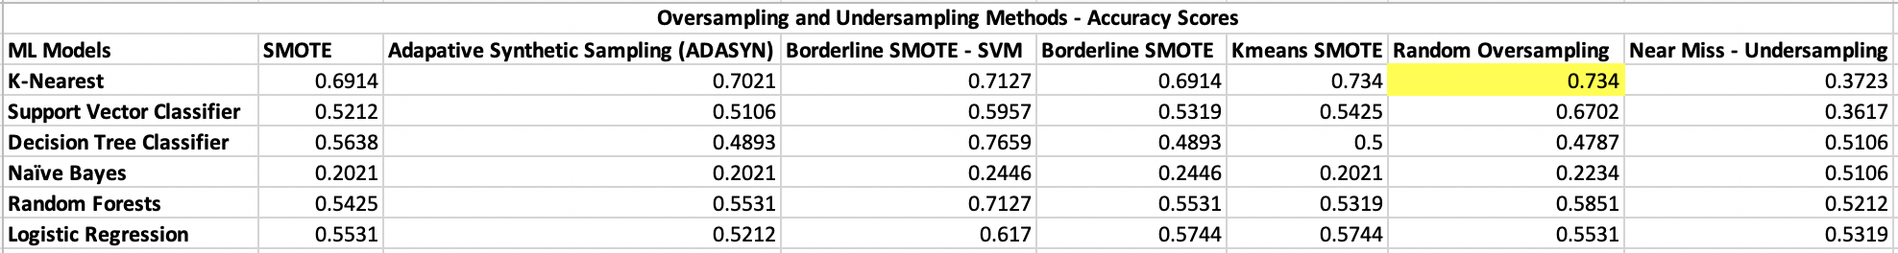
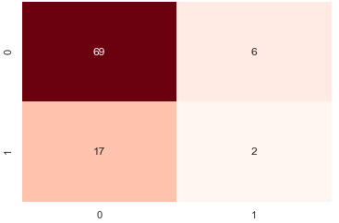
Results- Post Sampling
KNN with Random Oversampling is the best model
Accuracy : 0.734
Cross Validation Score: 0.90
Confusion Matrix for k-NN with Random Oversampling

Slide 14
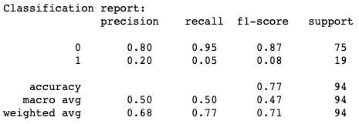
Ensemble Techniques
Ensemble using Random Forest, SVM and KNN.
Weighted voting RF-1,SVM-2, KNN-3
76% Accuracy
Low F1 and AUC score
Classification report for Ensemble models

Slide 15
Impact
Exploring another new application of Data Science in Medicine
Comparison of competitive ML models’ performance for this nature of patient datasets
Supervised Learning, Classification problem type
Viable models chosen in our project will actively help predict the survival of lung cancer patients 1 year post-op
Applications:
research
clinical trials
surgery

Slide 16
Future Improvements
Data Addition
Adding scanned images to the dataset
Utilizing Deep Learning to predict survival
Increase robustness of best model to incorporate other cancers

Slide 17
References
“Sinai Hospital of Baltimore.” Cancer Types - Lung Cancer | Cancer Institute, Lifebridge Health, www.lifebridgehealth.org/CancerInst/CancerTypesLungCancer.aspx.
Konstantin, K. “Four Years Remaining.” The Data Science Workflow, Four Years Remaining, 29 Nov. 2018, fouryears.eu/2018/11/29/the-data-science-workflow/.

Slide 18


